Slide 1
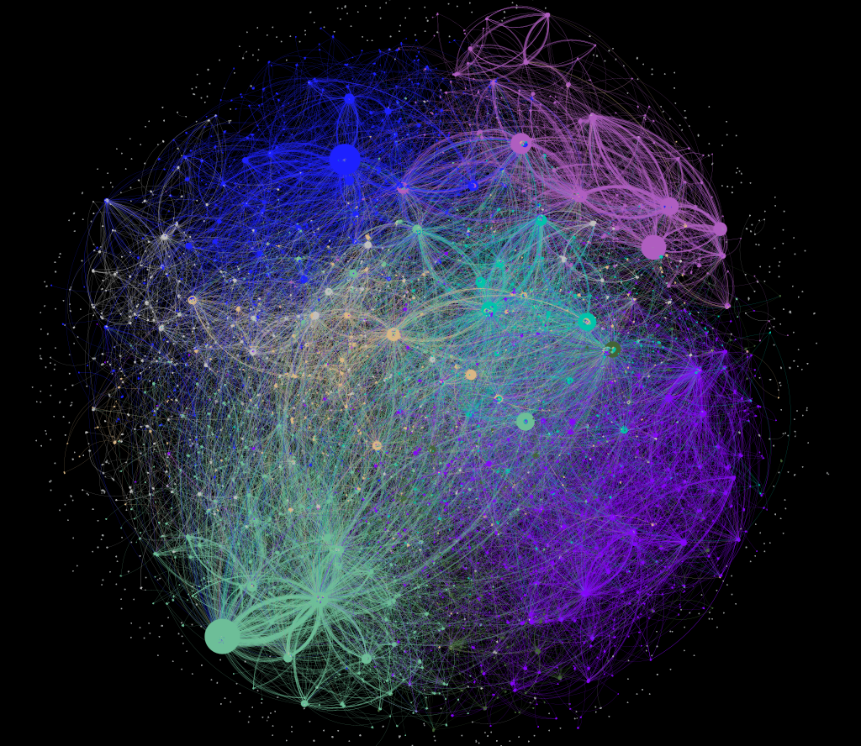


Gender and Language Differences in the Growth of Wikipedia
Eline Brunke Aarhus
Karen Visby Østergaard
MSc Thesis
January 2025
Notes:
KAREN (15 seconds)

Slide 2
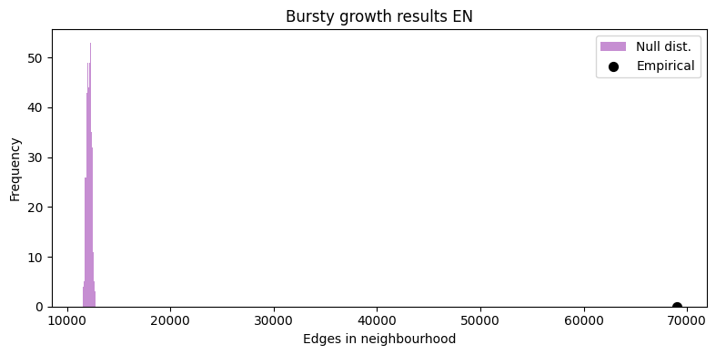
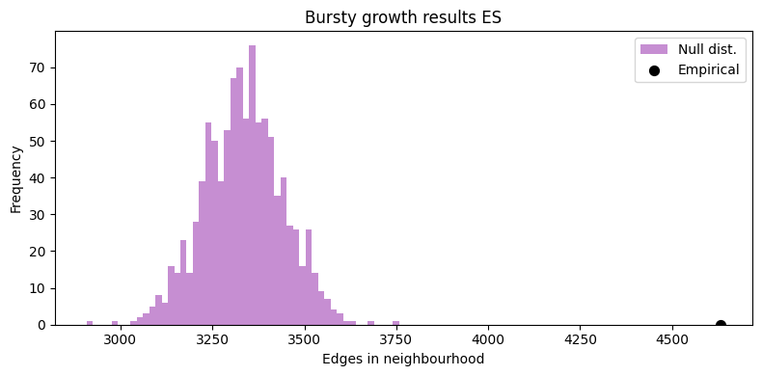

Errors found since hand-in
The implementation used to find the empirical count of bursts in our networks counted both out- and ingoing edge. We have since hand-in corrected it to only counting outgoing edges
The empirical counts became lower, but the plots are still similar, aside from the Spanish network being a lot less bursty than previously
The equation mentioned on page 33 is Equation 4.10
Notes:
ELINE (1 minute and 30 seconds)
We want to start by clarrifying two errors that we have found since hand-in.
Suspicious of large burst counts. Went through the implementation. Found that we didn’t count out-edges but all edges. Fixed fairly easy with networkX framework to only count out-edges.
This ended up reducing the empirical counts of the network’s burst by a lot, but the difference between Null and emp are still very evident like in this new English plot for everything but the Spanish.
Spanish difference are now much closer to the null, which makes sense
Aside from this, we also found
After handing in we grew suspicious of the very large burst counts for each of the networks. We reacted on this by going through our implementation again and found that instead of counting the out-edges that the nodes grew we counted all new edges on nodes…
this meant that everytime a node gained an out-edge AND an in-edge they would both be counted, as well as if a node grew an in-edge, which is not what our definition of bursty growth is
We were able to fix this (fairly easy) as soon as we found it, by using NetworkX framework to count the edges instead.
The biggest difference was for the spanish network, where the difference is no longer as drastic as with the other three networks. This does align more with what we expected, as it has fewer edges total, fewer edges pr node and the lowest amount of edges added each year.
Aside from this, we also found that the equation mentioned on the bottom of page 33 was missing a number. Equation 4.10

Slide 3
Outline
Scope
Key Findings
New Findings
Data and Visualisation
Network Communities
Network Growth
Notes:
KAREN (45 sekunder)
Having that cleared up, here is the outline….
We will not go in to deept with our results but rather discuss…
Having that cleared up, here is the outline of our presentation today. We will start out by revisiting the scope we introduced in the introduction of our thesis and move directly to the key findings of the project. Since we handed in, we have also made some new findings based on some of our thoughs from the discussion, and we will introduce these before moving on to discussing the thesis it self. That we will do in three parts: Data, Network Structure and Network growth. In these 3 parts we will not discuss our results as much as we will talk about the choices we made and what we could have done differently.

Slide 4
Scope
How can we scrape revision data from Wikipedia articles about scientists and classify their gender?
How can we construct networks across time and language versions?
Are there differences in network structure across language and gender?
Which growth patterns can be detected in the network across language and gender?
Notes:
ELINE (45 sekunder)
The scope was to investigate the structure, growth and gendered bias in networks from the English, German, French and Spanish wikipedia websites.
We we limited the scope to center around scientists and THEIR wikipedia representation, as we wanted to research bias and knew that women historically has been underrepresentated in this field.
Our research centered on ansering these four questions which are

Slide 5


Key findings
We found gendered bias in Wikipedia before we even constructed the network
The network exhibited a scale-free structure, with the highly connected nodes in the hubs being mostly male
Networks differ in size, degree distribution and connectivity across languages
Despite differences in networks, communities across languages are similar
All language versions of the network exhibited bursty growth behaviour
Notes:
KAREN (2,5 min)
Having the scope defined, we will move on to 5 of the key findings in our thesis.
Many challenges in defining scientists – but also our very first finding
Difficult to quantify
remember that we are reproducing this bias
The first is that we found a gender bias before we constructed the network. As mentioned in the thesis, we had many challenges in defining our scientist-list, but in this process we also unexpectedly had an important finding for our thesis, namely how biased the list-system in Wikipedia is. These lists are created by editors and they are therefore as many other things in Wikipedia a product of the editors own bias. Not having a 100% certain list of who all notable scientists are this is however difficult to quantify exactly how big the bias is. We therefore compared the two lists ”List of chemists” and ”List of female chemists” and found that the overlap between the two lists was very small and many women where missing from that first list.
OVERVEJ at drop kemikere
Having scraped the data and created our networks we had 4 more findings we would like to highlight. Firstly, the four networks we created differed not only in size but also in degree distribution across languages. Around 50% of all nodes has 2 or less edges
Secondly by looking at the degree distribution we found that all 4 networks had a scale-free structure with few highly connected nodes and many poorly connected nodes. We found that the mostparts of these hub-nodes were male scientists and that the female nodes in general were less connected.
We also computed communities for each network and looked at their similarities across languages. We found that despite being created from 4 very different network there were clear similarities between the communities detected.
Lastly we investigated the growth of each network and found that despite differences in size, all networks exhibited bursty growth behaviour, but the growth behaviour seemed to reflect the network size and connectedness as seen from the Spanish network. We also found that nodes grew differently across languages.
Der var bias allerede inden vi lavede netværket
Communties på tværs af sprog stadig er pænt fucking ens
At alle sprog var bursty: more than expected growth bursty

Slide 6
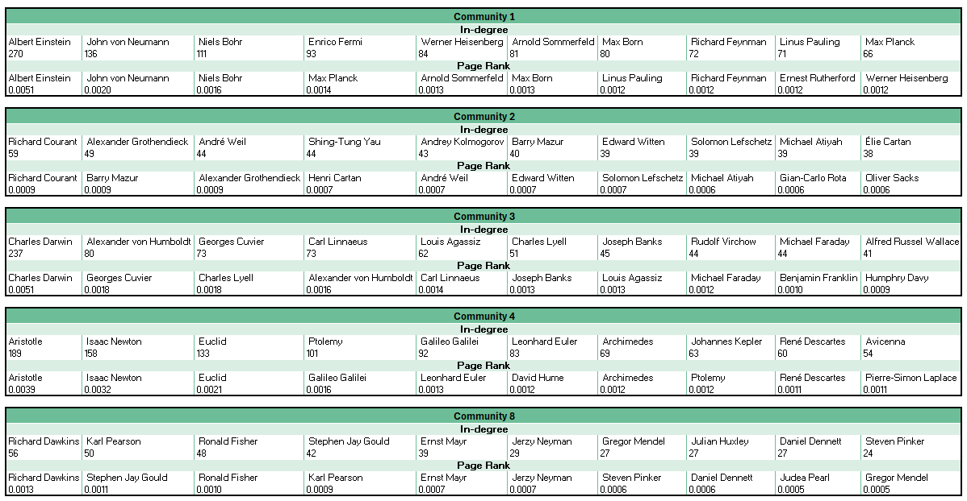
New findings
Page Rank
New names in Top 10 – especially for Community 2
Values for in-degree
The in-degree of the most connected nodes in Community 2 are much smaller
Notes:
ELINE (1 minute and 30 seconds)
After hand-in, we remained curious about many aspects and choices that we had made along the way, as well as stuff we never had time to do.
We did investigate, Since completing regretted that we did not use PageRank, especially because we used it in the beginning
Not just how many links an articles has but also on the importance of the articles linking to it, would have provided another angle
We also were curious about the individual in-degree
Measures for physics and math below, in degree’s for top 10s are really different
Pagerank also varies from in degree, showing that most popular and most popular among important articles are different. Order is also different
Because of this curiosity, we did investigate a few thing afterwards. Firstly, we have since completing the analysis regretted that we did not compute and use PageRank as a measure
(especially because we had computed very early on in the process and then forgotten about it)
We regret not using it since it’s a measure that doesn’t just depend on how many links an articles has but also on the importance of the articles linking to it. And while we did use the in and out-degree, the page-rank could have provided a third measure with a bit of another angle.
We also were curious about the individual in-degree values for the top connected nodes in the communities, since the average in and out degree did not reveal how different the communities are from each other.
We did both measures for the communities and you see the measures for community 1 and 2 (physics and math) in this table. Firstly, where the average in and out degree were quite similar for these two communities, the in-degrees of their top 10 most connected nodes are VASTLY different, confirming our suspicions about the math community having less connected hubs. The PageRank of the top 10s is also different from the in-degree, showing that there is a difference between who is just popular and who is popular among important pages. We see that the top 3 in the physics community and Richard Courant of the math community remain the same placewise, while the other scientists differ.

Slide 7
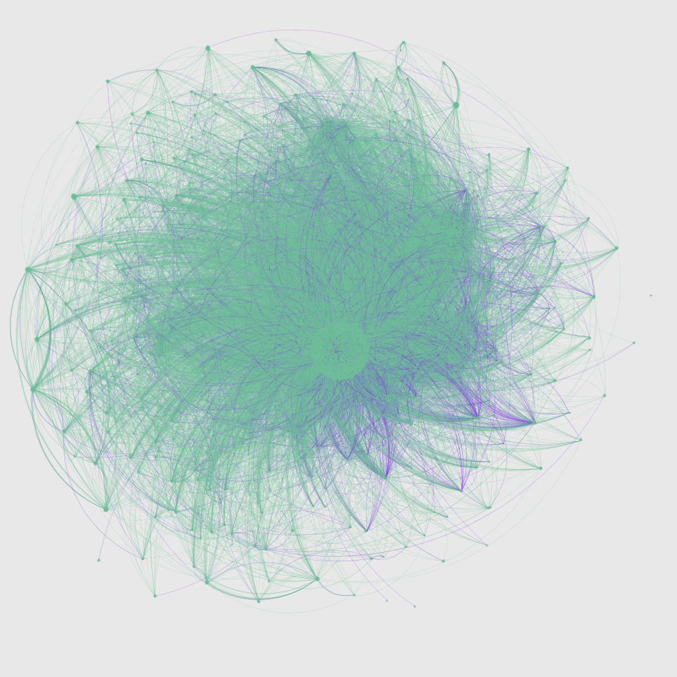
New findings
All revisions for Community 2 in 2024 has been scraped
2,419 names, 13,238 revisions, 12,343 unique time stamps
Comparing the List of Mathematicians to Community 2 only 32% are in Community 2
When counting the bursty growth within this year we counted 26 bursts for community 2 out of 1005 edges added
Notes:
KAREN (2,5 min)
We could not help but to scrape a bit more data
THE GRAPH
List of mat = com 2, com 5 (also math) and com 4 (the old one)
However 80% of com 2 are from the list
Since handin we have also scrapped all revisions from community 2 in 2024. This includes not only the persons from the list, but also links to universities, persons outside the list, countries etc. We did this, because we were curious to see how the network would look if more nodes were included.
The Wikipedia API allows us to scrape a maximum of 500 revisions at a time, which limits how long a time period we can scrape from at a time. In this case, the person with the most revisions had 50 revisions in 2024, so it has not been an issue. From the 2,419 persons in community 2 we had more than 13,000 revisions at more than 12,000 unique time stamps. This means that almost all revisions were the only one at that exact time and we can almost sort the revisions in time.
The graph seen from this slide is how community 2 looked by the end of 2024, so the very last revision of each scientist in community 2. The green is nodes outside our list and the purple are the scientists from community 2. We see that added more information naturally makes the graph even more complex and that there indeed are hubs outside the community. The edges are colored by target node.
We also scraped the revisions of all mathematicians since we first assumed that there was a overlap between these and community 2. However, only 33% of the mathematicans from the list where grouped in community 2. We did not have the time to investigate this further, but it did open a bunch of new questions to the community detection we had done
Lastly we have investigated the growth of community 2 in 2024 having all time steps and found that … We have not been able to compare this to a null model, but this would have been an exciting next step
Der var bias allerede inden vi lavede netværket
Communties på tværs af sprog stadig er pænt fucking ens
At alle sprog var bursty: more than expected growth bursty
Graf kun med matematikere (evt med hvor matematikere har én farve og andre connections har en anden farve)
Bursty på matematiker data
Limit of max 500 revisions pr person using the api

Slide 8

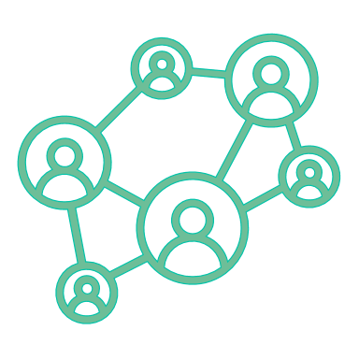

Data
Revisions
Function works well but the output quality relies on input quality
Wikipidia page ID’s could have helped us
Scientists in scope
We had to limit the number of revisions we could scrape per person
We already utilised three computers, but we could also have used servers at DTU
Attribute estimators
Both the gender and birth functions produced satisfying results
Birth year function could however be improved
Notes:
ELINE (2,5 minut)
Now we want to share our thoughts on how our research went, and what we would have changed or done differently if we were to do it again.
Starting with our revision function the output quality relies on input quality.
We search for partial matches, meaning that sometimes the results was very irrelevant and not about scientists at all. But doing full match search didn’t find all. Partial was a compromise and we cleaned up after.
If we want to perfect this function, we could have used the Page ID instead of names, for more accurate searching
With our datascrape, we did make a choice about the scientists in scope, where…
We did this because of time concern, but we could have used servers at DTU
Finally, we also implmented our very important attribute estimator. But because we implemented gender first, we had already cleaned the data which made the implementation of birth year much harder.
Example removing “-”. If we had done it the other way around we imagine that birth year would become more accurate
We are start with our data scrape and modelling. With our revisions, our function works well but the output quality relies on input quality:
the search function would find matches that was not even remotely close to anything in our list, because it would use a partial search. However, doing full match searching resulted in many not being found. This was caused by different spelling and different list setup frpom when we scraped the names.
So in order to be on the safe side we chose to just scrape every partial match that we could and then clean it up afterwards.
Perfecting the lists to solve this issue would have taken ages, but we could have used the page ID’s of the articles instead.
With our datascrape, we did make a choice about the scientists in scope, where . Running i batches and testing during scraping
Our attribute estimators ended up being very important to us, as gender is the background for the entire bias analysis of our research. But by the order of which we chose the implement it, we actually set ourselves in a more difficult position than if we did it before we prepared the text. If we had done it before, we imagine that the results would have been more accurate

Slide 9
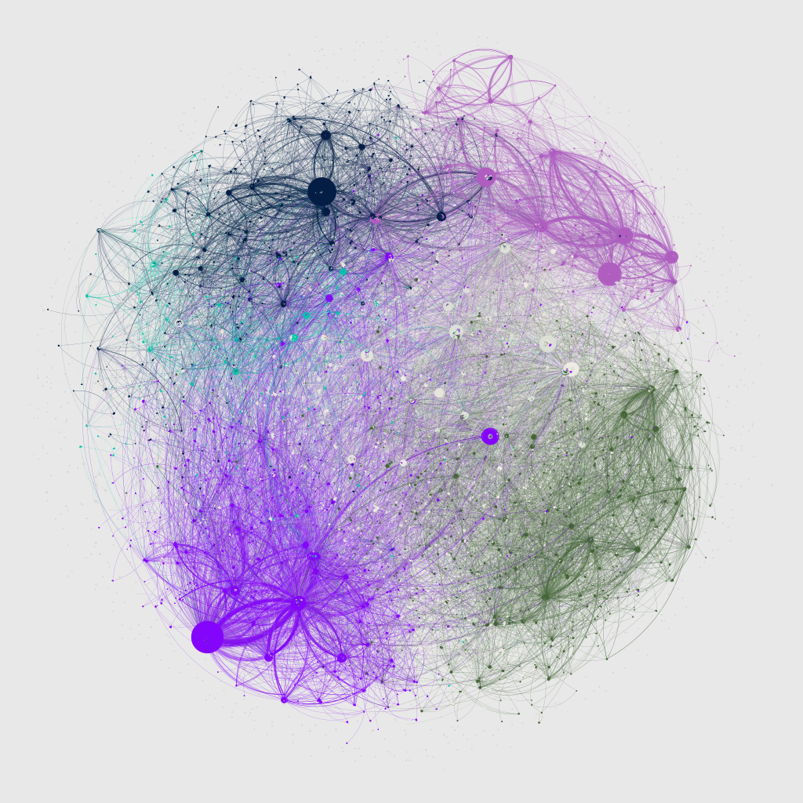
Network visualisation
Having more than 23,000 nodes is difficult to visualise
The NetworkX visualisation function performed poorly for the large graphs we wanted to visualise
Moving to Gephi decreased run time and increased readability when using OpenOrd as layout
We did detect structures in Community 2 in our Gephi visualisation we did not detect in our analysis
Notes:
KAREN (1 minut)
Moving on to the visualisations of the networks we quickly discovered that this was not an easy task.
We spend a lot of time using different NetworkX layouts without great succes and with long runtimes. After having experimented with networkx and force atlas in Python with slightly better results we moved on to Gephi. Here we found that OpenOrd was the quickest way to create plot we could understand and intrepretate.
As mentioned in the thesis we could despite being large and difficult to read at first glance see some interesting structures in the graph – the main thing being that community 2, here colored green has no large hub-nodes but several smaller nodes. Further this plot allows us to see how the communities are placed related to eachother
Generel struktur:
Vores valg vedr datascraping lavede, visuelt, en KÆMPE graf – var det dumt?
Hvad nu hvis vi havde ikke-personer med? Hvad ville det gøre for vores i allerede forvejen ujævne degree distribution? (præsenter degree distribution)
Vi har virkelig ikke begrænset os i metoder og burde måske have begrænset os og valgt nogle af vores metoder fra?
Hvordan kunne vi idenficere bias allerede her og hvilket info mangler vi for at kunne detecte det?

Slide 10


Network Communities
None of the considered methods were able to detect overlapping communities
Links to non-biographies (universities, countries etc) could act as new hubs. But we would be curious as to how they would be assigned
A little list tracking showed that the communities weren’t 100% reproduced from the lists of scientists
Sub-communities, within our big communities
Notes:
ELINE (2 minuter)
As we saw with our findings, there was a connection between our community structure and the context of the wiki-articles.
However, we chose to use a method that do not take into account overlapping communities. Curious, multiple big interdisciplinary scientists fit in different.
We also found that when tracking the Mathematicians list, the list didn’t equal communities. However, there were definetly correlation between the lists and the communities, further into
In the new findings, we also included links to non-biographies about universities, countries and such. These nodes could definitely change the structure. Act like hubs or bridges
Finally subcommunities. Happy with big but curious about small.
This is something that we are curious about since we know that there are multiple big interdisciplinary scientists that would fit in many different communities
We also suspected that the field of study and list that the scientist were scraped from would have a big impact on the community structure. But we also found that there might be a correlation between the list that we scraped from and the community that they end up in. This is something that has sparked our curiosity even more and something that would have been even more exciting to go into.
In the new findings, we also included links to non-biographies about people, but to universities, countries and such, and found that this resulted in MUCH more data. These new nodes could change the structure of our communities as we saw that they begun to act like hubs, almost like bridges, between a lot of the nodes. They could be acting like bridges between communities, but using InfoMap they would still be assigned to a community
Finally, we would have liked to also investigate possible sub-communities within our communities. We are happy with the method that we chose, since we were able to detect big structures that consisted of people from similar fields of science. Having said that, we are still curious about possible subcommunities within them, seeing if we are able to detect on a more detailed level who has worked together, for example in community 2, where there wasn’t as many hubs as in the others.
Communities:
Communities og deres styrker – burde vi have valgt communities der var 100% stærke?
Hvordan kunne vi idenficere bias allerede her og hvilket info mangler vi for at kunne detecte det?

Slide 11

Network growth
As with the communities, we could also have included non-scientist connections, but had to limit the network at some point
Committing to a smaller node selection could have allowed us to scrape all revisions resulting in at smaller network
With unique time stamps, we would expect fewer bursts. Differences in number of revisions for male and female articles
Notes:
KAREN (1,5 minut)
As Eline mentioned…
Had we instead committed to fewer nodes… more info on growth patterns for these specific nodes, less on the large growth structures
If we were able to get unique time stamps for the large network…
Detecting bursty growth in one neighbourhood could be difficult if there is growth happing other places with in the same short time frame.
As Eline just mentioned for the communities, here it would again have been interesting to add nodes from outside our list, but we had to stop somewhere and as seen from our new data it does not simplify the graph, so we limited us to the defined scientists.
Had we limited the number of nodes in our network even more, we could have scrapped all revisions and had exact timestamps to order the revisions in a timeline. This would give us more information about the small subset of the scientists in Wikipedia and how they grow, but tell us less about the overall growth patterns of Wikipedia.
We expect that having unique time stamps would result in fewer bursts as networks of this size grows several different places in very short timeframes. This means that, under our current definition of bursty growth, the order of which a neighbourhood grows could be interrupted by growth other places in the graph at the same time. Since we assume that bursty growth is more likely in the year-to-year framework we are curious to see what more time stamps would reveal.

Slide 12



Final thoughts…
We are proud of…
Our work with the data and attribute detecting
The bias that we were able to detect in our networks
Our teamwork and way of working
Our biggest challenges were…
Limiting ourselves and not getting side tracked
Defining and scraping the data
Building networks for other language version based on English lists
We dream of…
Scraping more data with all revisions
Compare with other fields than science
Working with a more exact network
Notes:
ELINE -> KAREN -> ELINE (3 minutter)
ELINE:
We want to round off this presentation by stating a few of the things we are proud of, along with our biggest obstacles and what we would do if we had unlimited time on our hands. Firstly, we are very proud of the data that we managed to scrape, as it was a challenging process that we
Finally, we are proud of Our teamwork and way of working, which first of all was our ability to work with 1000 different things at once. We were good at making plans but also revisiting them and checking in If they were manageable or if we should change course or alter it.
KAREN:
There is no doubt that this project has been challenging in many ways as well and among other smaller challenges, here the 3 largest are listed. First of all, we do not think we could ever completly finish this project since we kept getting new ideas and go in 5 different directions at the same time. It has been truly challening to keep focus but that has also been what has driven us the last 5 months, so it is not a completly bad thing ;-)
The first large challenge we faced was to scrape the data. As mentioned both defining the names of scientists we wanted to scrape the revisions of and actually scraping the revisions. Working with very long run times limited us in the scraping process.
Lastly, we choose to built our German, French and Spanish networks on the lists found on the English Wikipedia. This gave us smaller and less connected networks, and we suspect that we missed a number of scientists that could have been essential in our analysis. We have how ever not yet come up with a method to solve this issue.
ELINE:
And finally, if could continue with this very interesting analysis, we would…

Slide 13
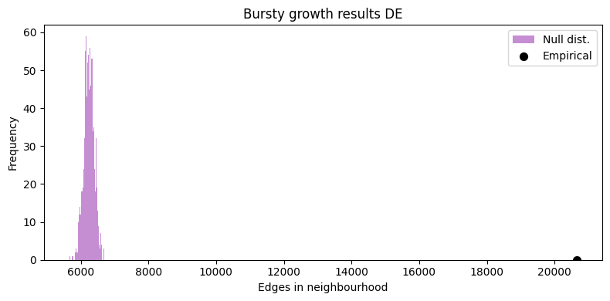
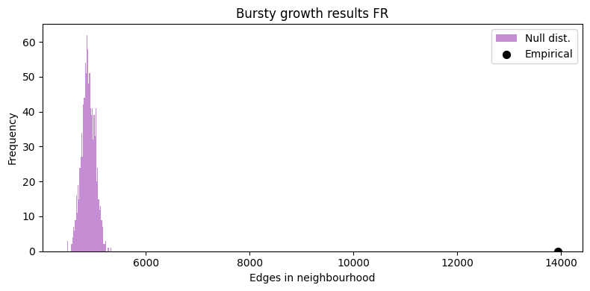

Slide 15
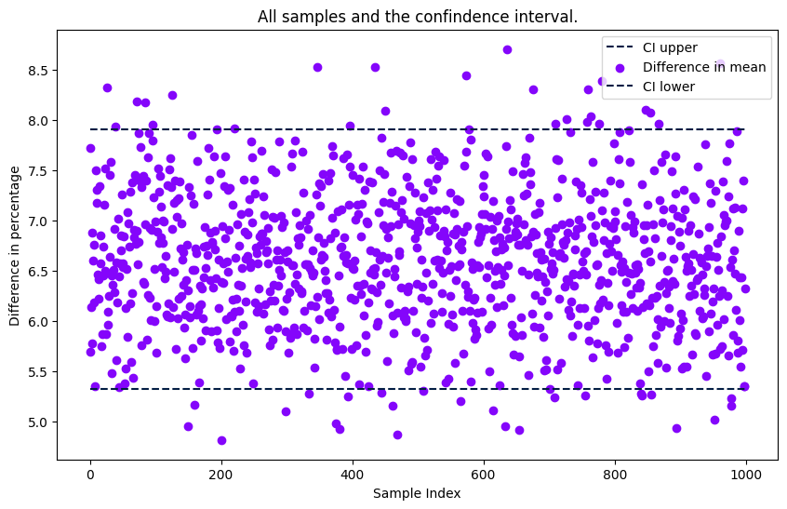
Figure 3.1

Slide 16
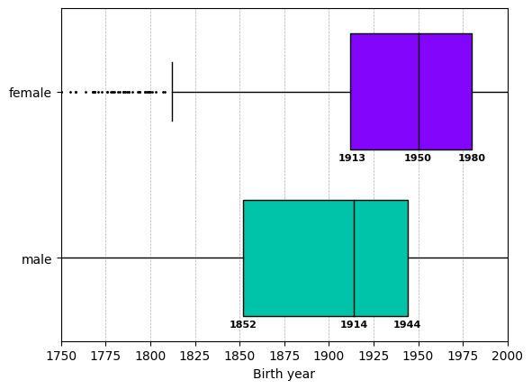
Figure 3.2

Slide 17
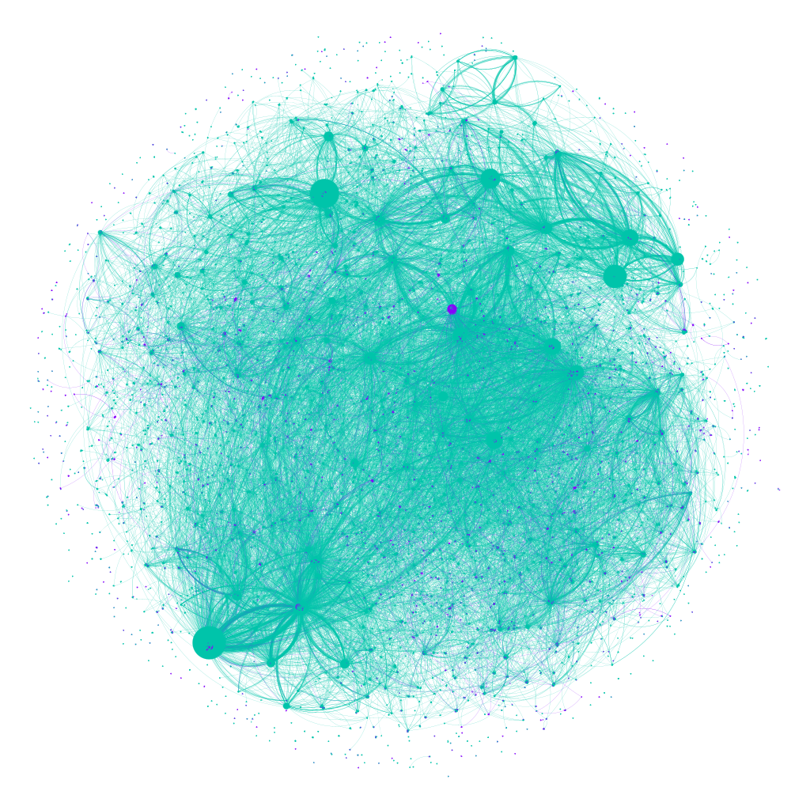
Figure 4.1

Slide 18
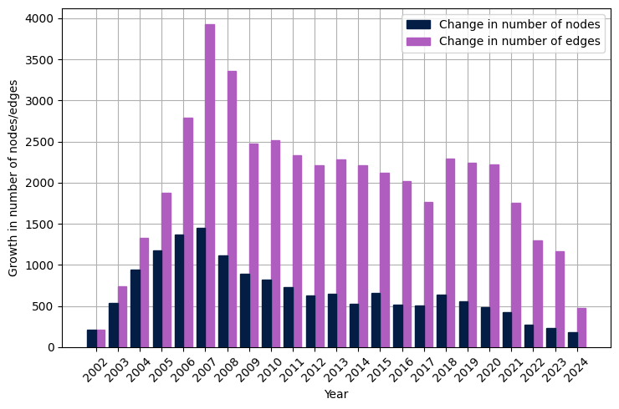
Figure 4.2

Slide 19
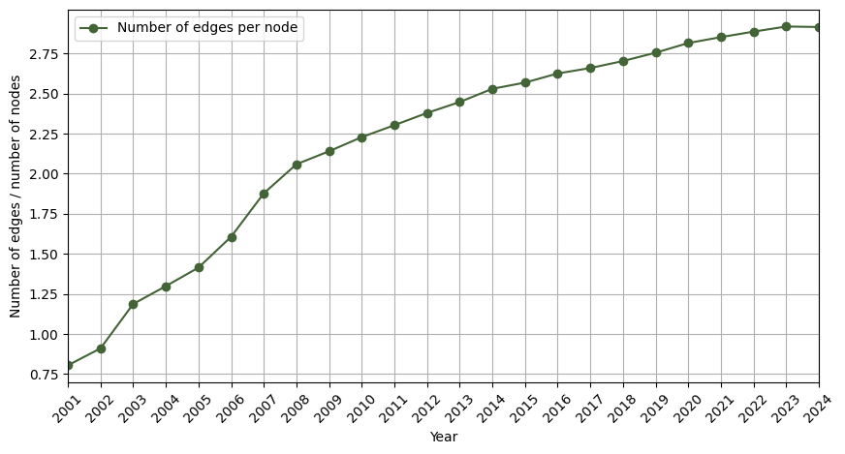
Figure 4.3

Slide 20
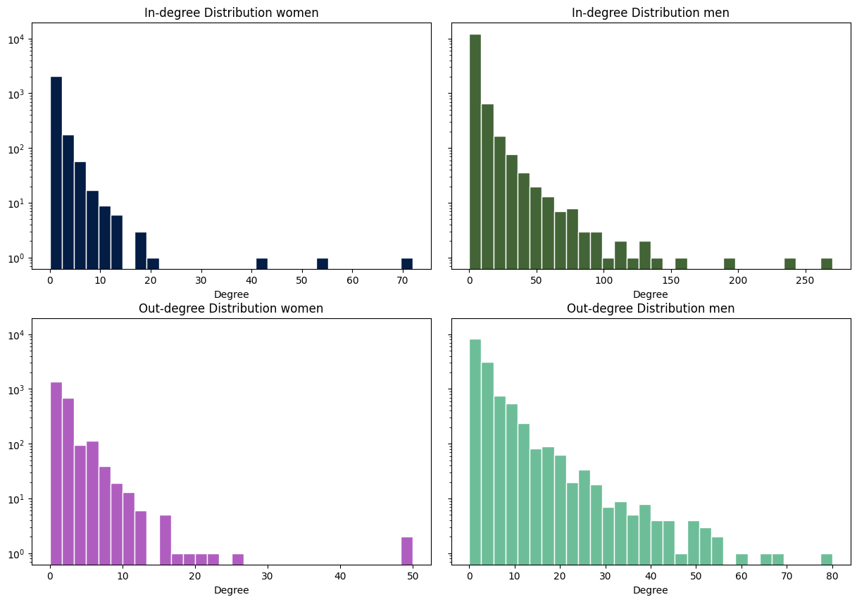
Figure 4.4

Slide 21
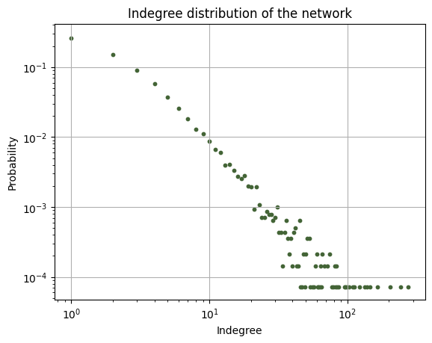
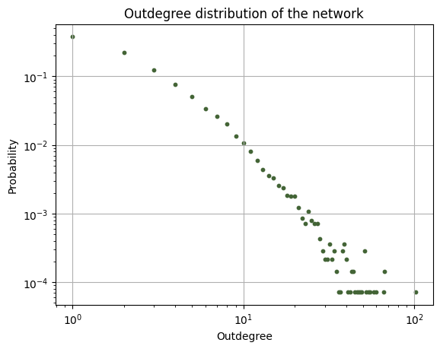
Figure 4.5

Slide 22
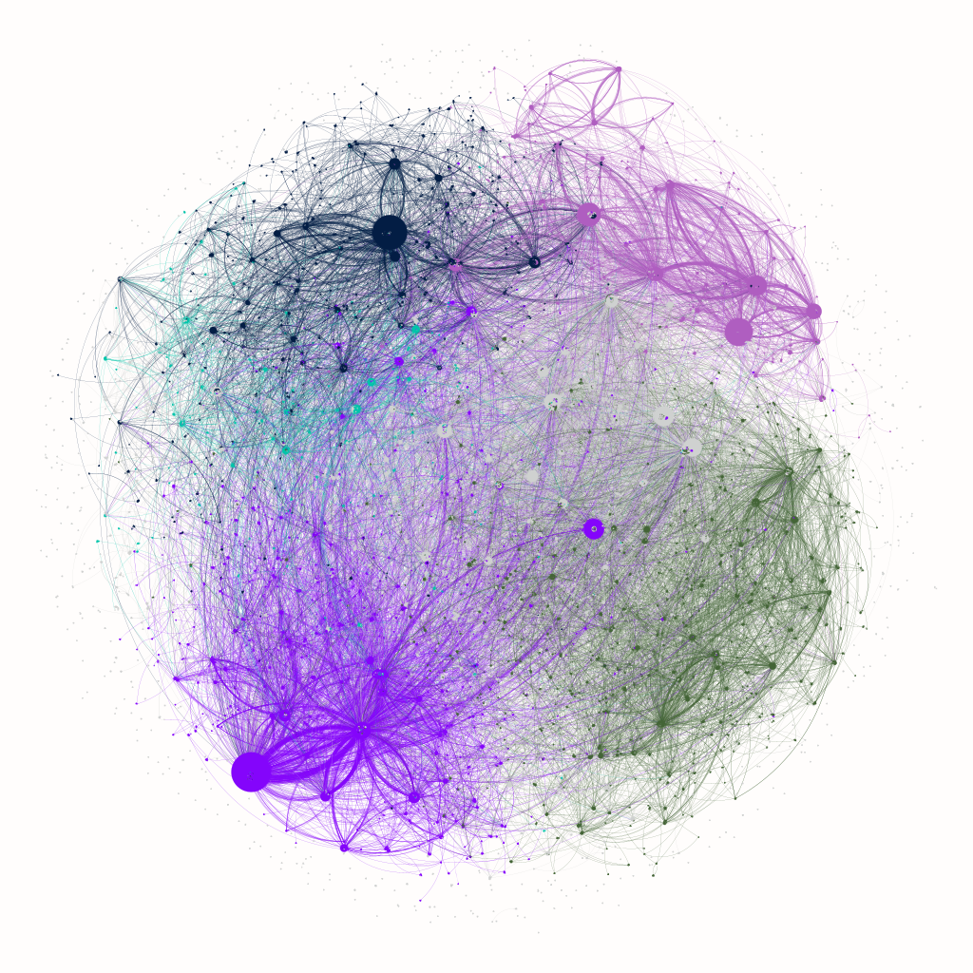
Figure 4.6

Slide 23
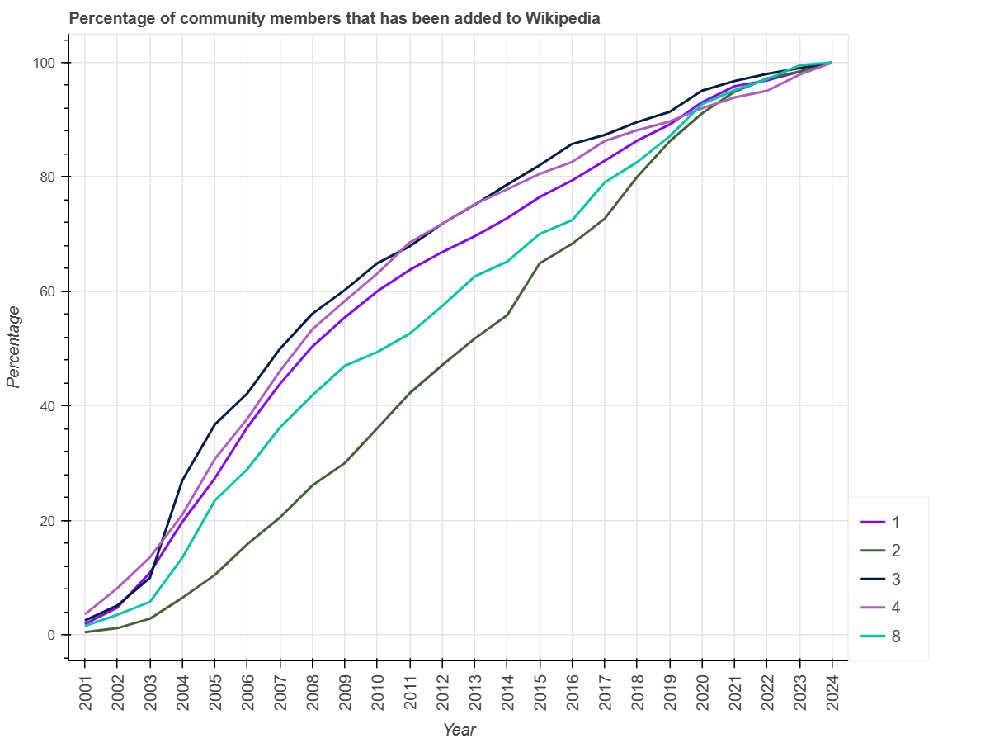
Figure 4.7

Slide 24
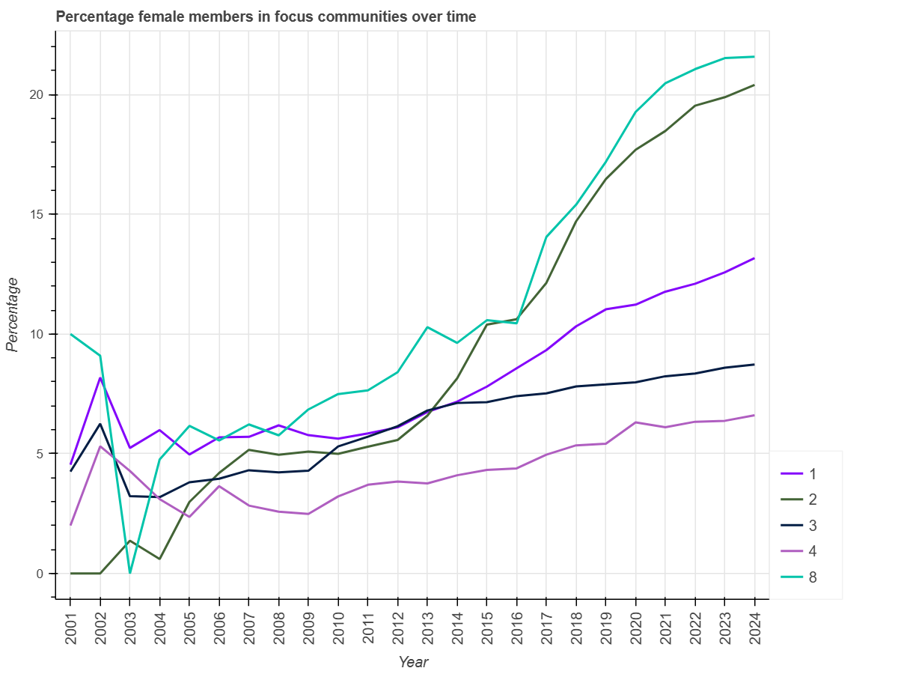
Figure 4.8

Slide 25
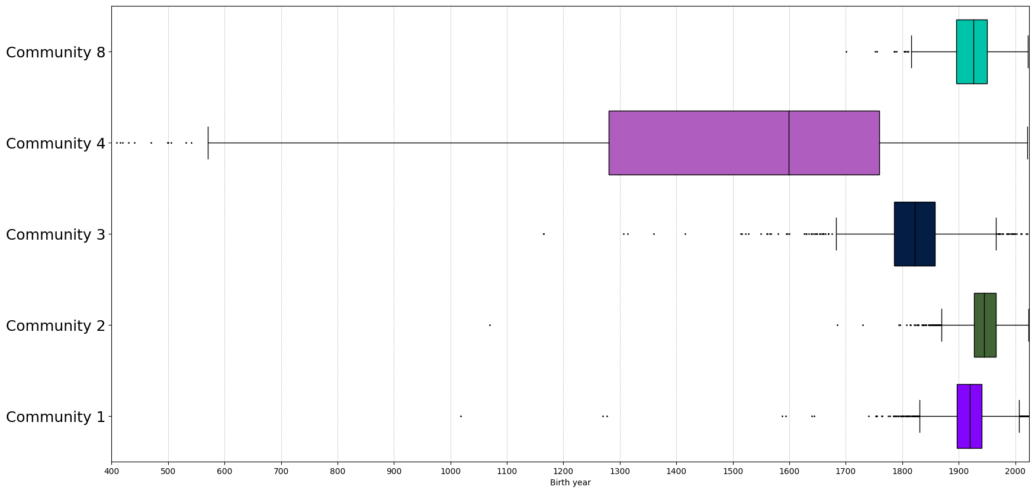
Figure 4.9

Slide 26
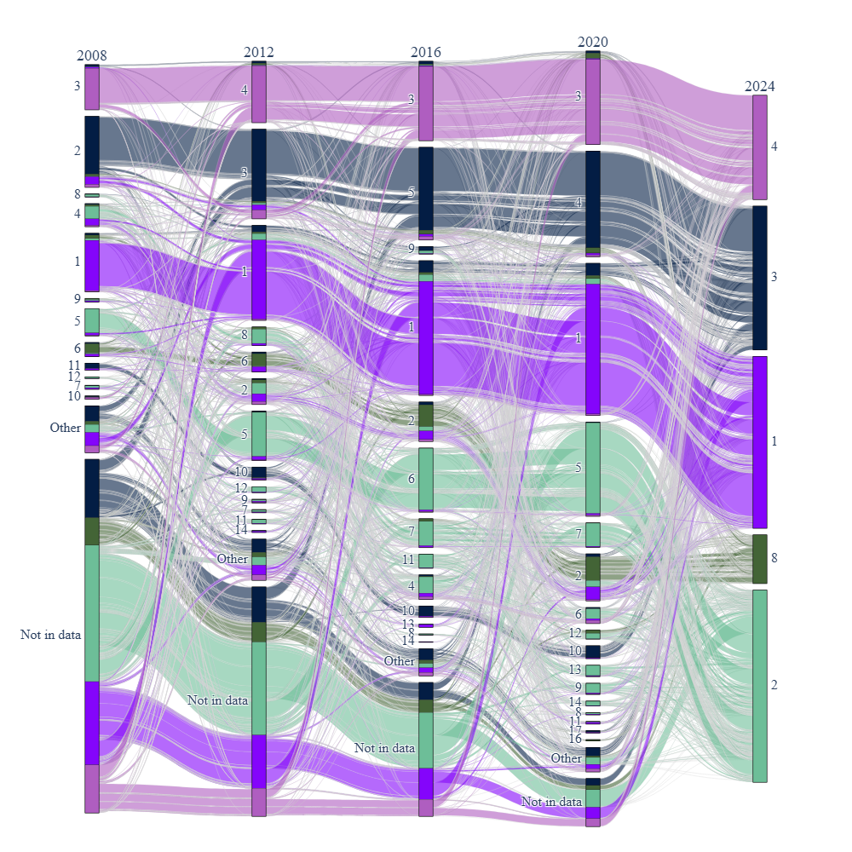
Figure 4.10

Slide 27
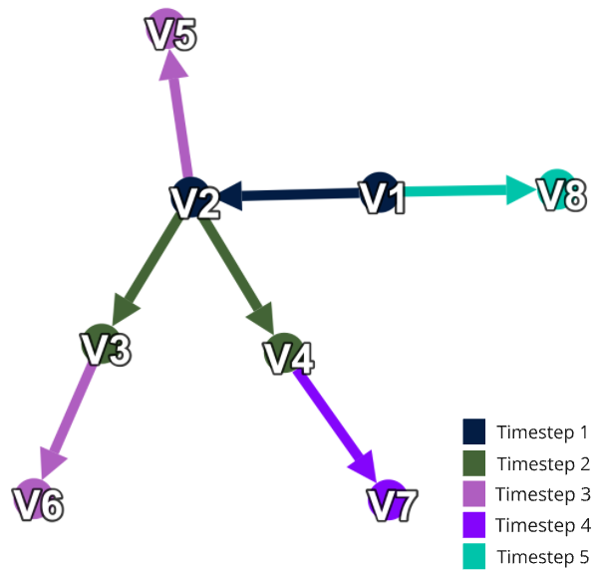
Figure 4.11

Slide 28
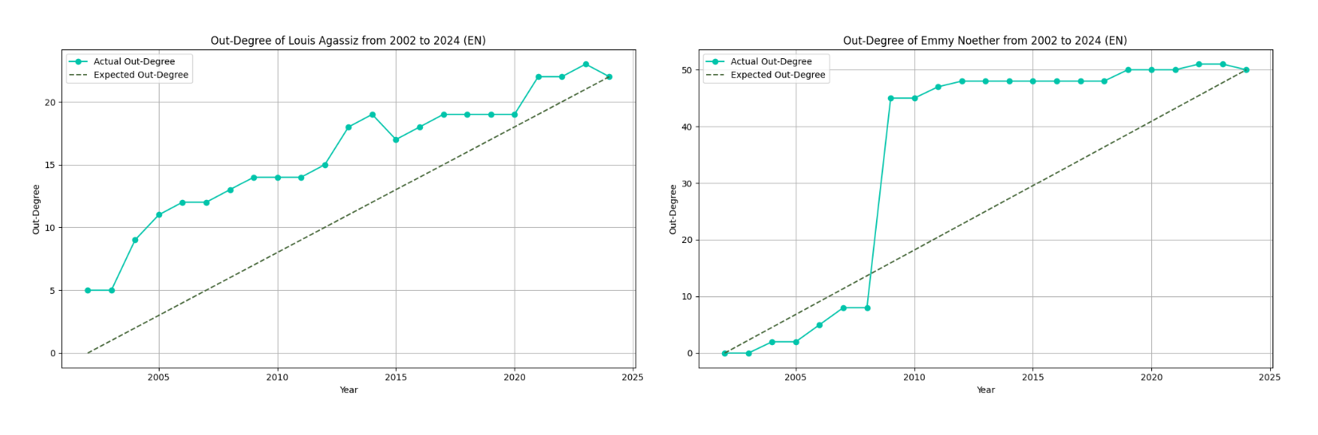
Figure 4.12

Slide 29
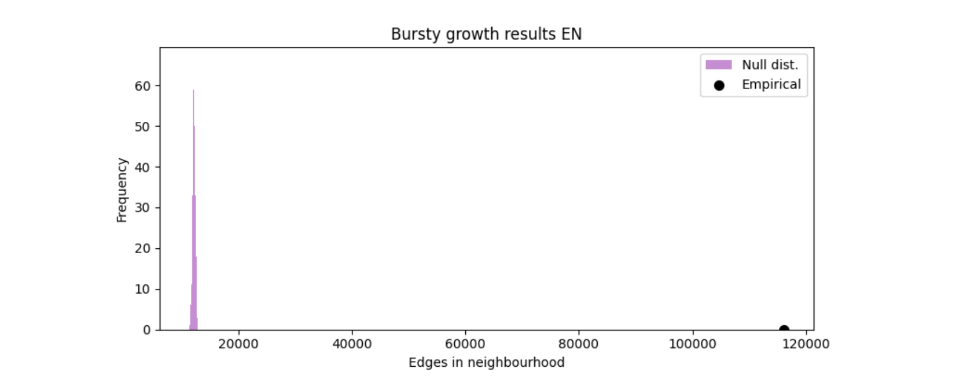
Figure 4.13

Slide 30
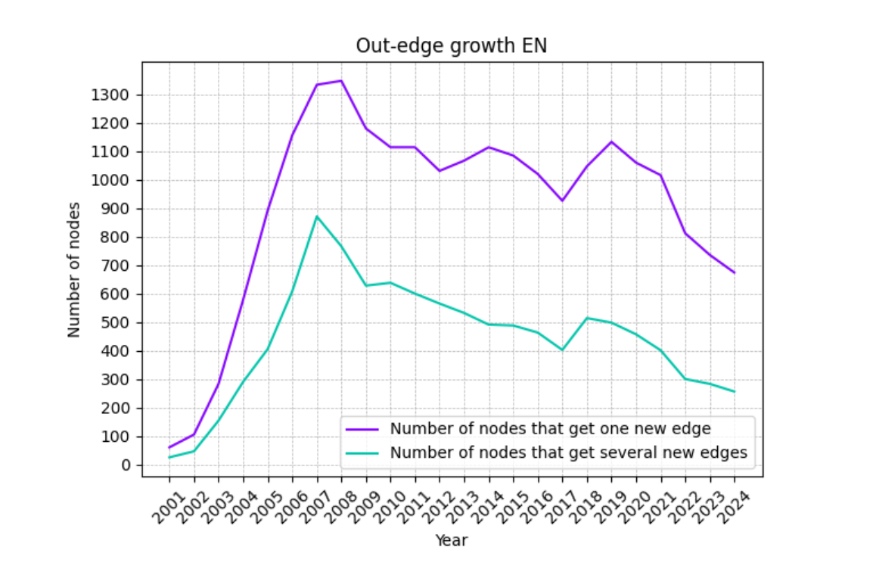
Figure 4.14

Slide 31
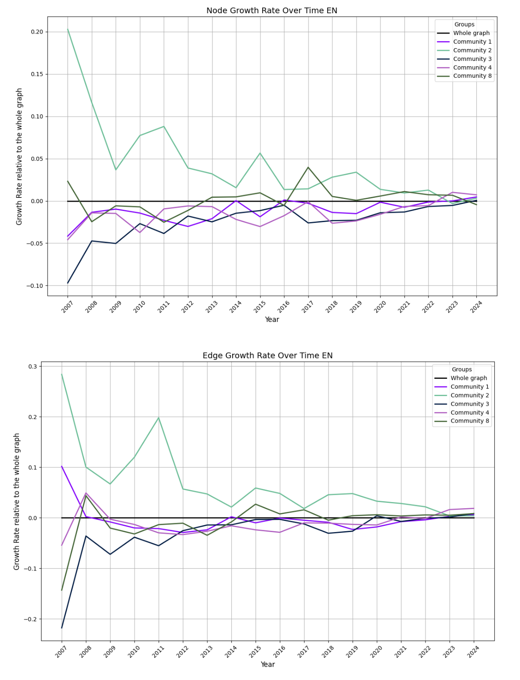
Figure 4.15

Slide 32
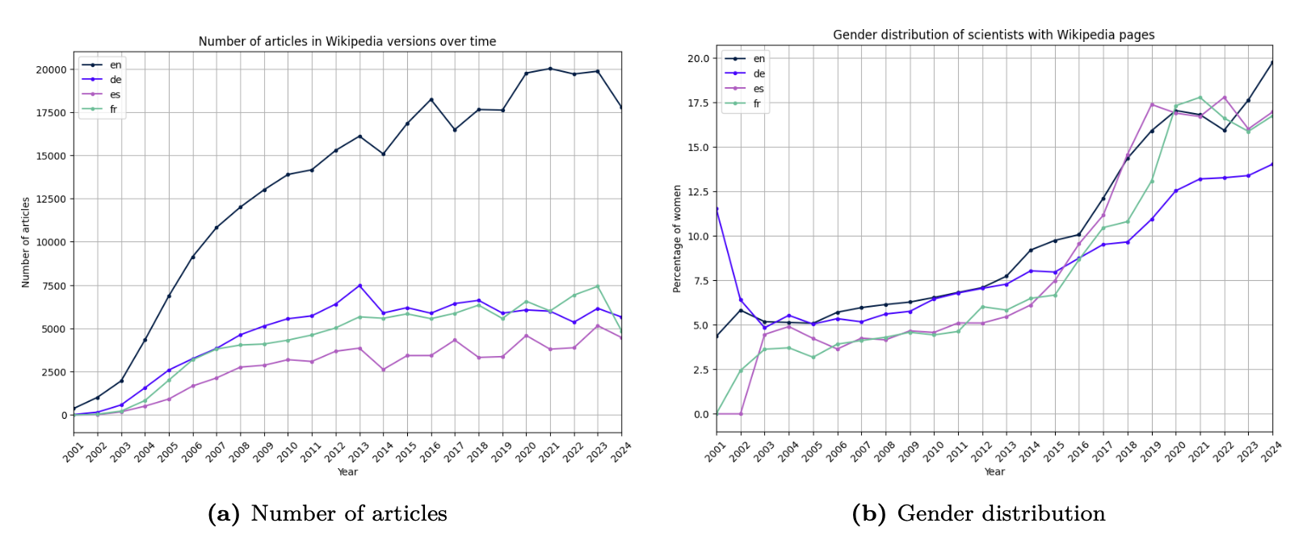
Figure 5.1

Slide 33
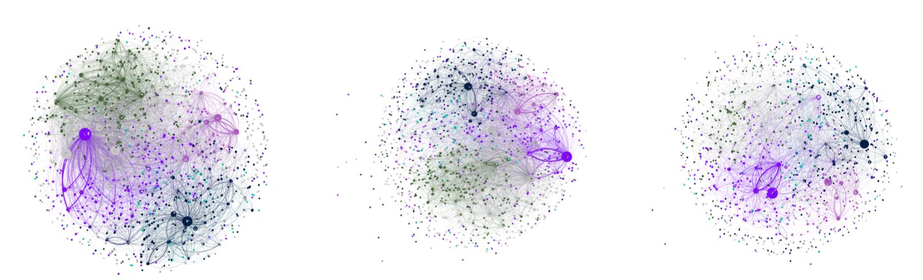
Figure 5.2

Slide 34
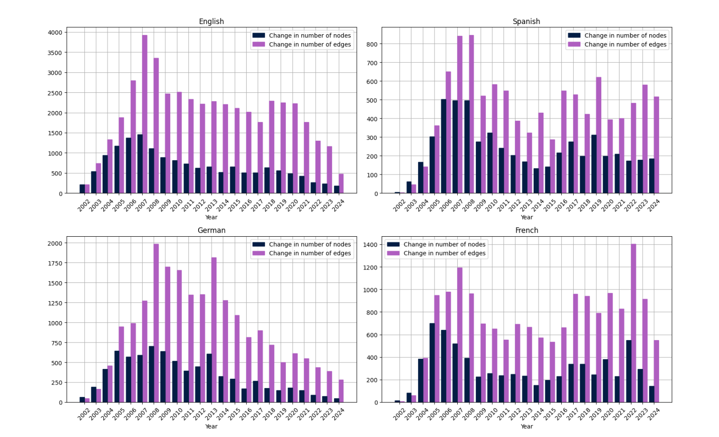
Figure 5.3

Slide 35
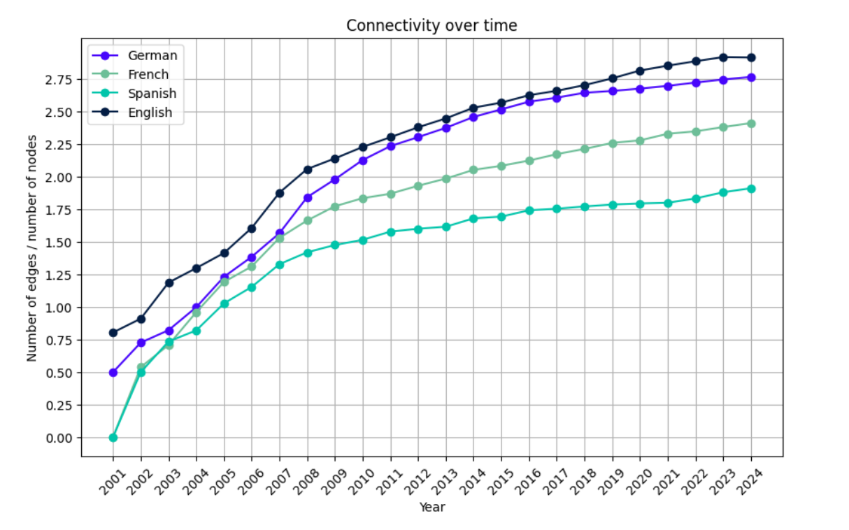
Figure 5.4

Slide 36
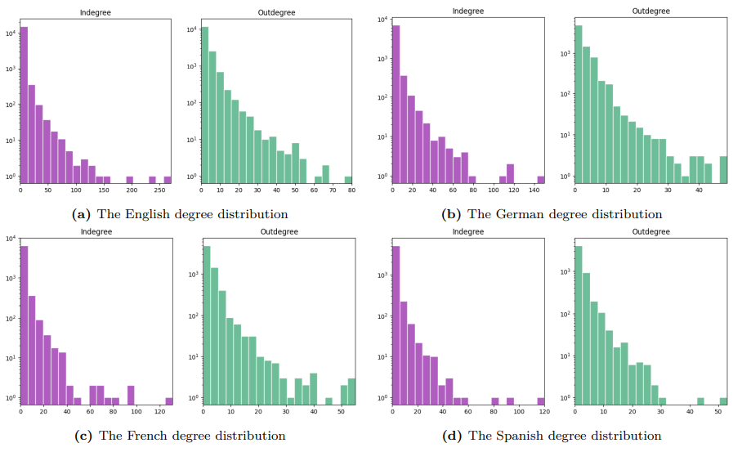
Figure 5.5

Slide 37
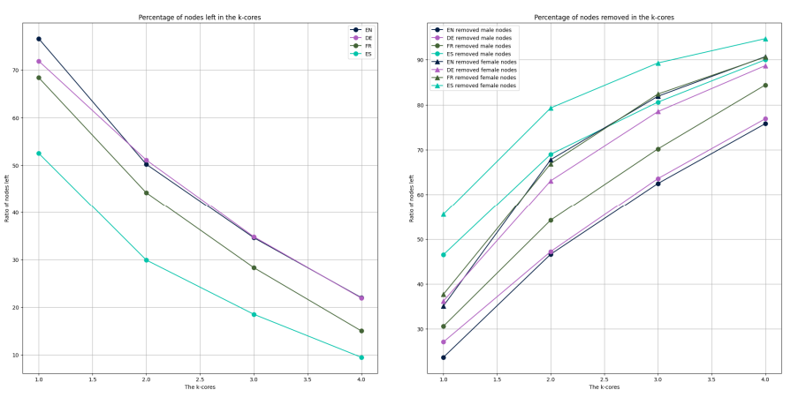
Figure 5.6

Slide 38
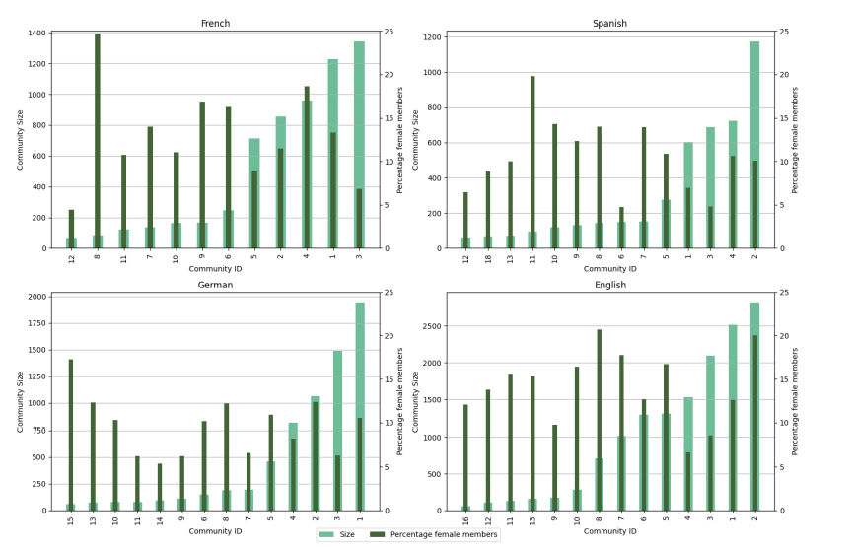
Figure 5.7

Slide 39
Figure 5.7

Slide 40
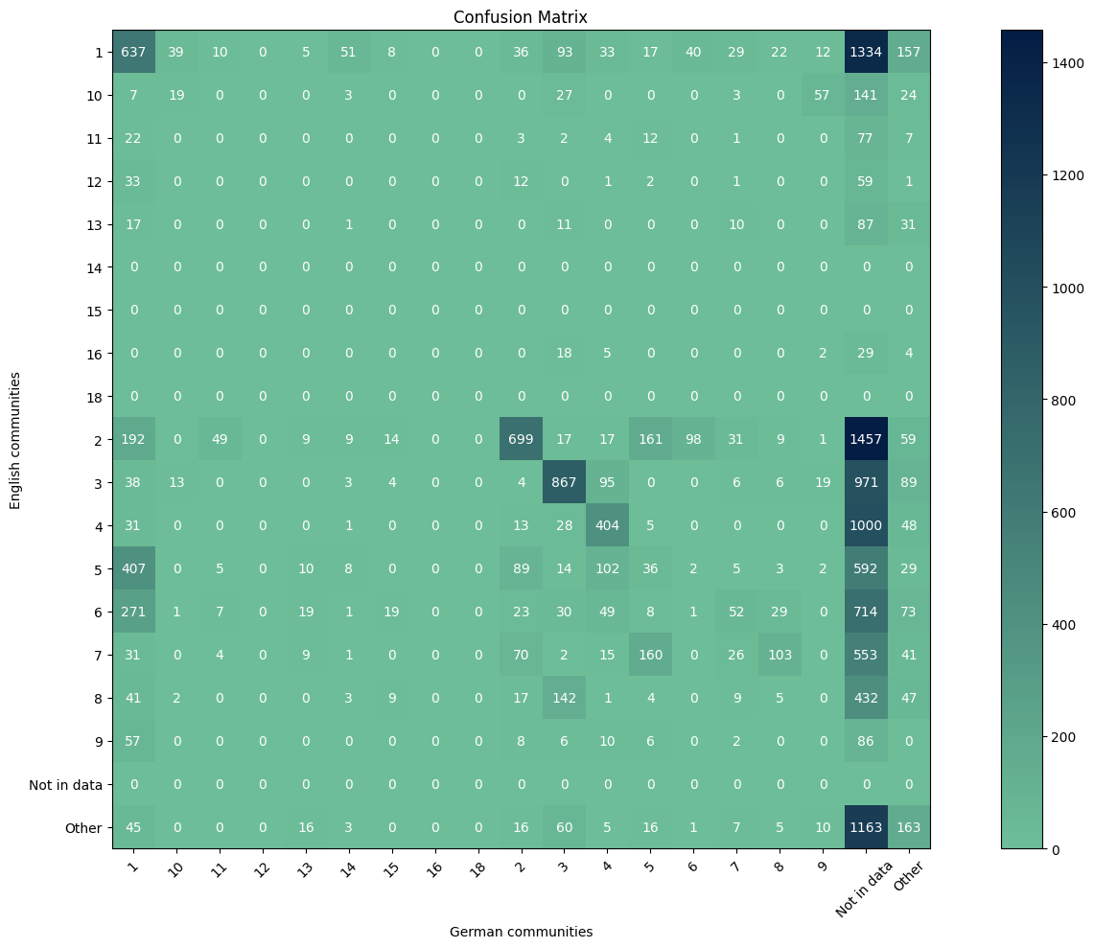
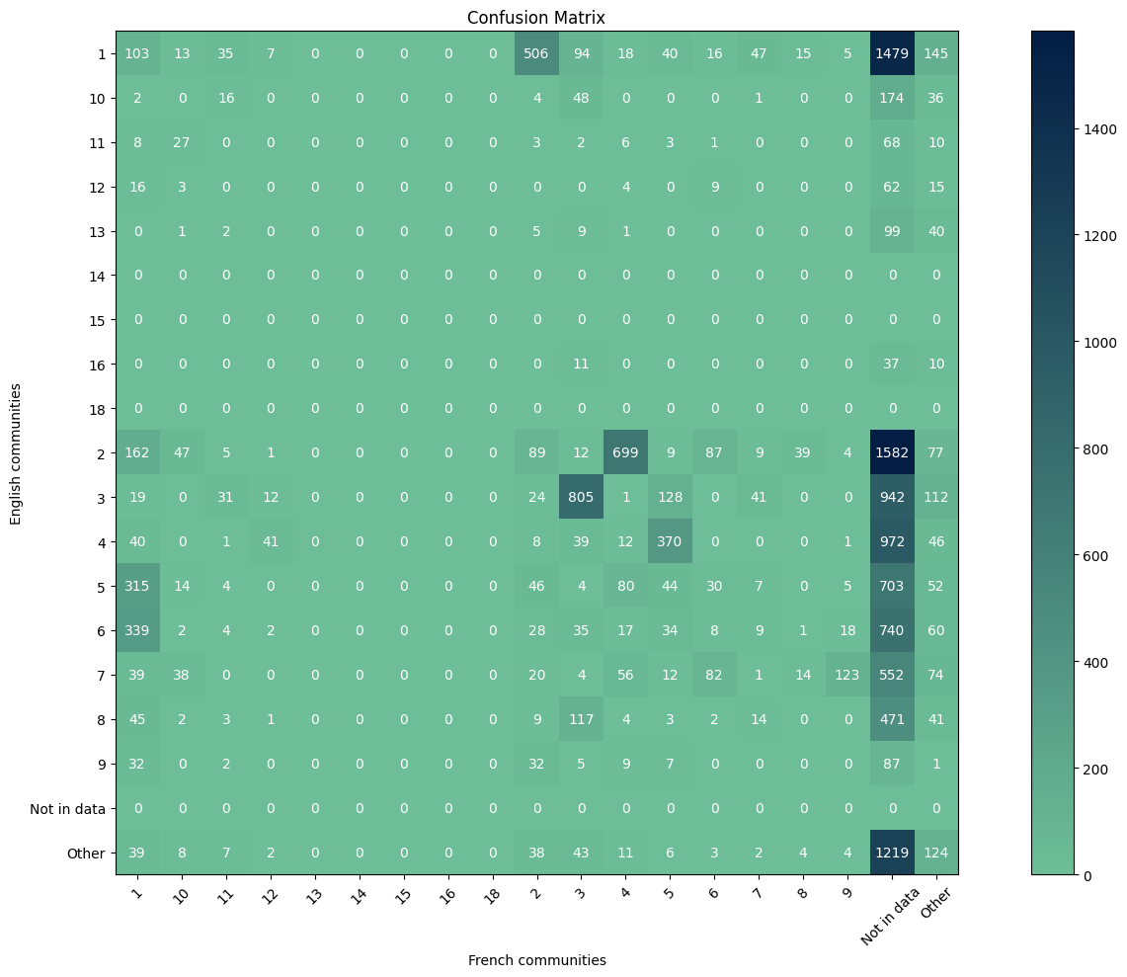
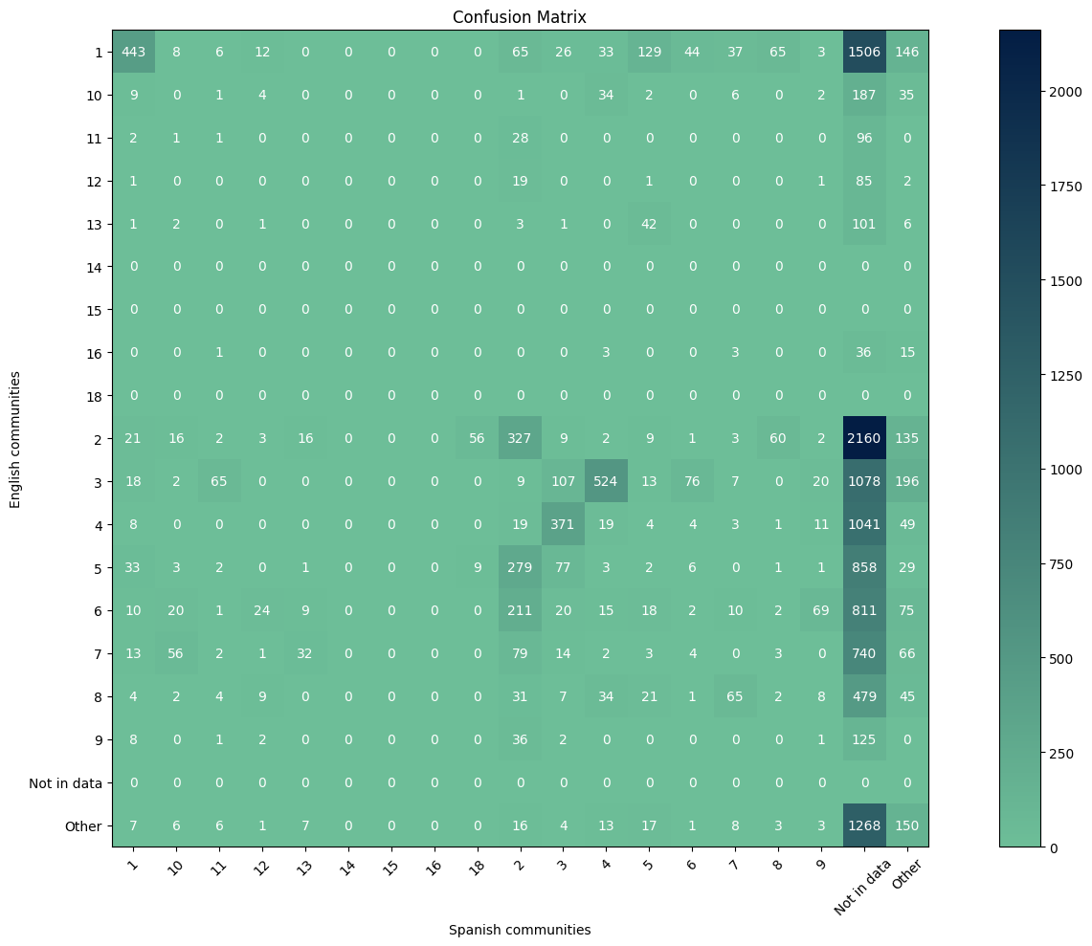
Figure 5.8-9
German French Spanish

Slide 41
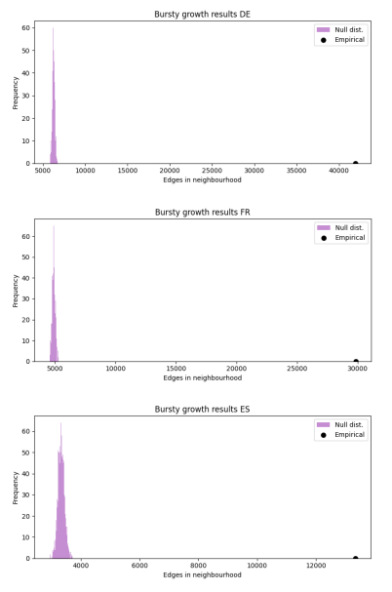
Figure 5.11

Slide 42
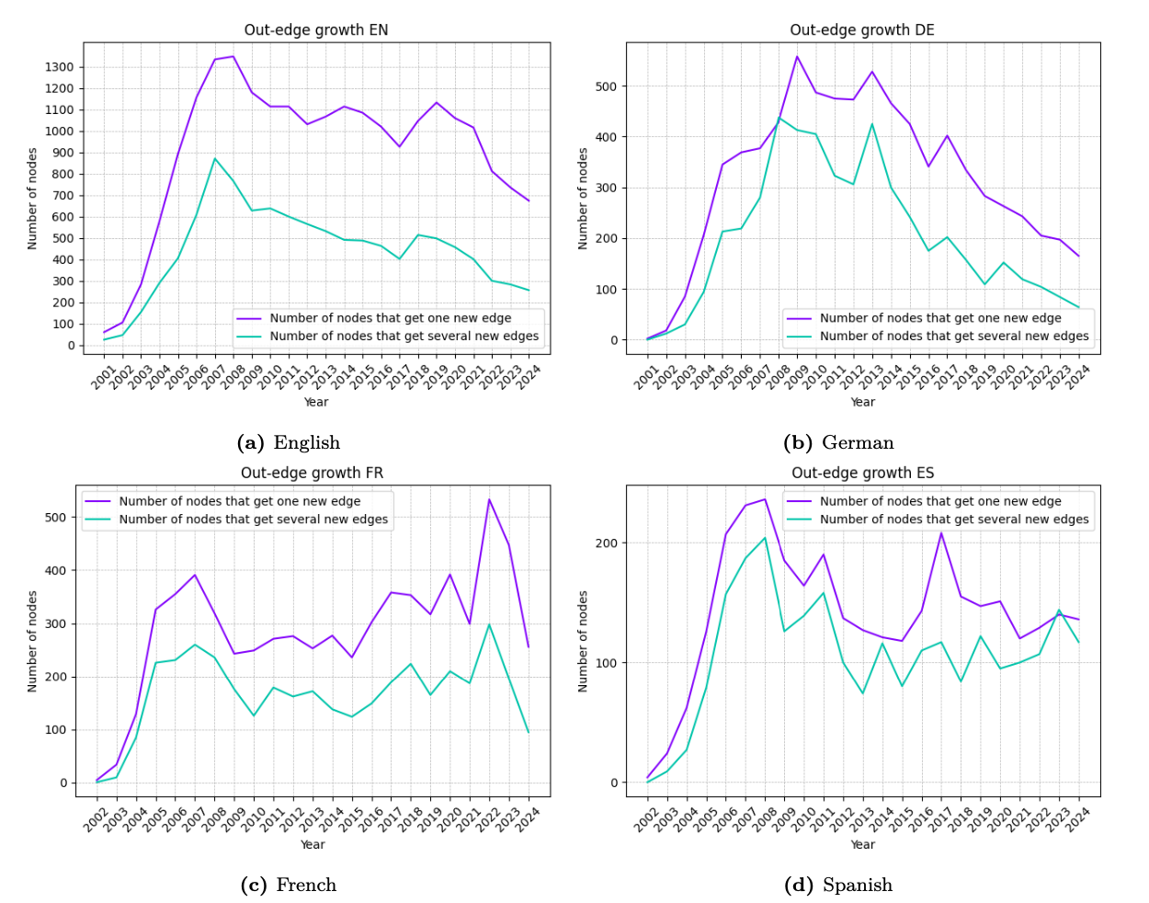
Figure 5.12

Slide 43
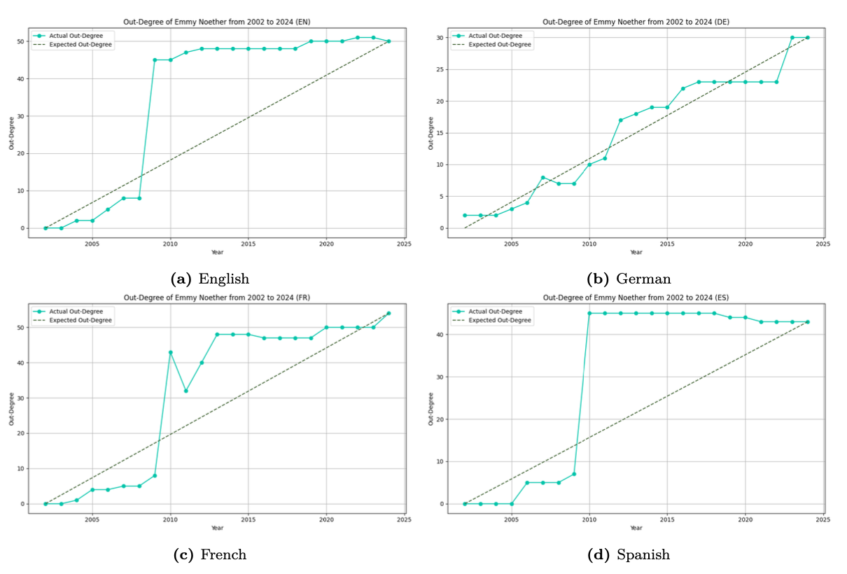
Figure 5.13

Slide 44
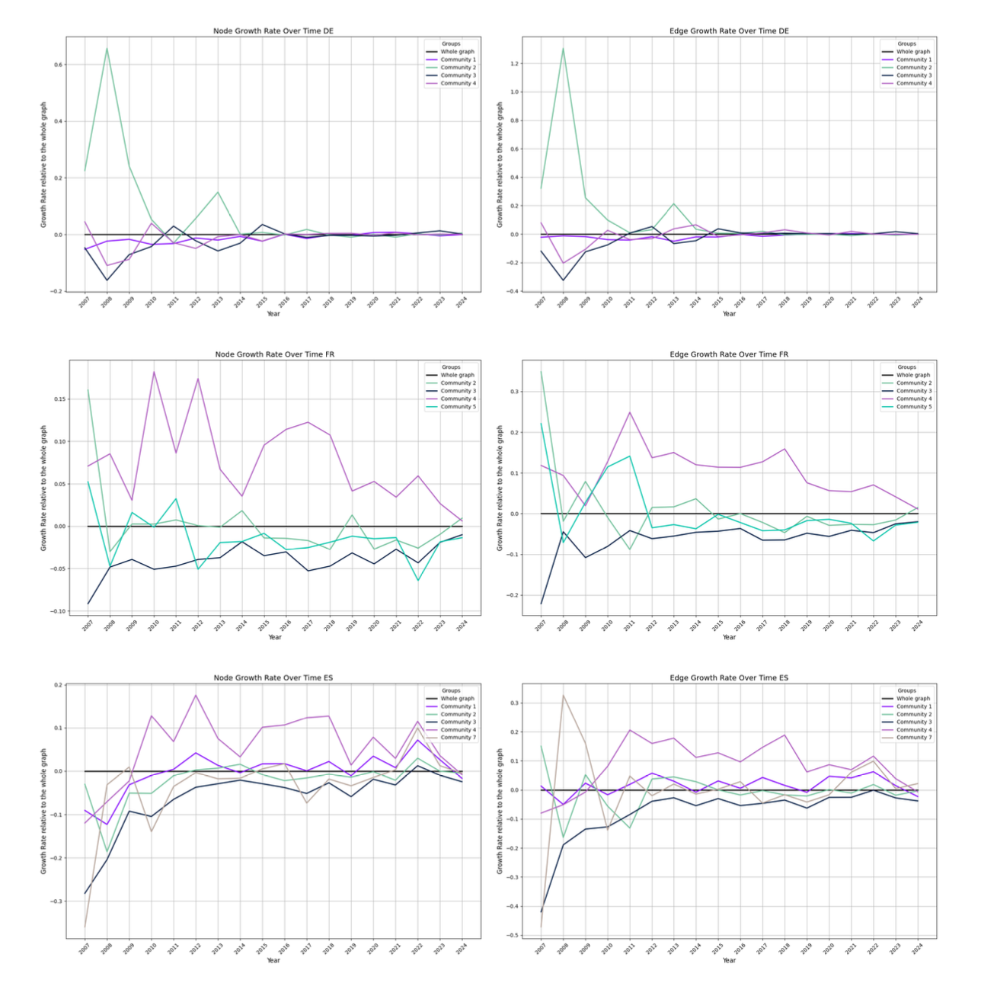
Figure 5.14

Slide 45
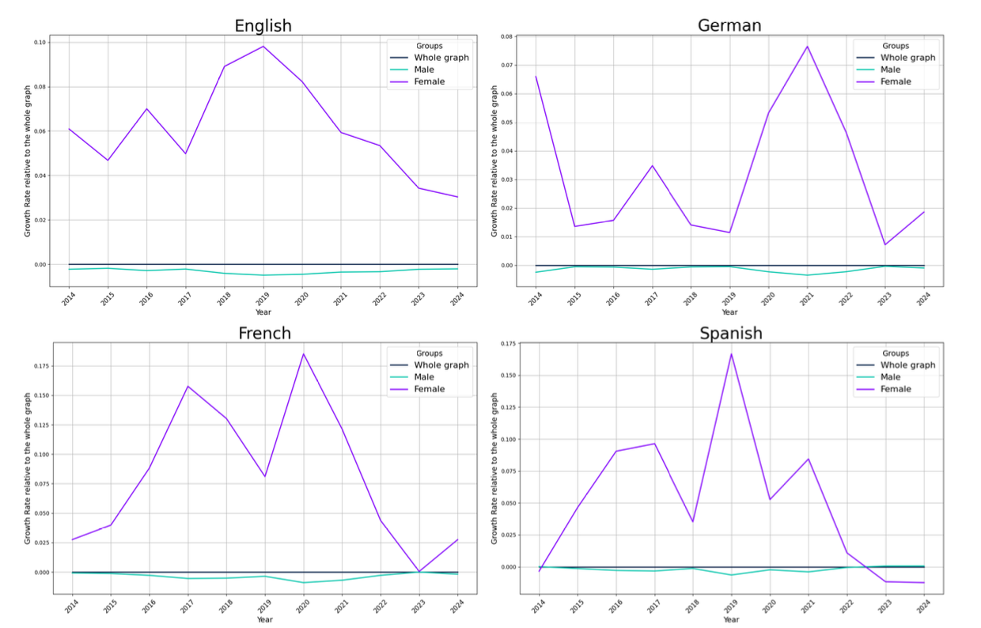
Figure 5.15

